Slide 1
Teacher Scholars 2015
Facilitator
Linda C. Hodges

Slide 2
Learning through teaching—Dena Aufseeser
Goal
Have student groups facilitate meaningful in-class discussion to
Draw connections, problem solve, and learn from each other
Assume the perspective of teacher, learn the material more deeply, and improve presentation skills
Promote student ownership of the class
Plan
Assessment
Ability to synthesize readings,
create effective discussion questions
facilitate meaningful discussion
Class brainstorms discussion strategies
Instructor models initially and guides critique
Assess students’ attempts and revise plan

Slide 3
Teaching visual thinking in Computer Science—
Jian Chen
Goals
Teach visual thinking/provide hands-on experience for practical real-world problem solving in a module for COMP 101
Plan
Use examples from news media in a team project to help students learn effective visual presentation
Assessment
Evaluate students’ work on homework and project
Notes:
COMP101 is part of the NSF-funded TUES (Transforming undergraduate education in science, technology, engineering and mathematics) project with the goal of increasing confidence in and retention of computing majors at UMBC, especially women and underrepresented groups. The goal of this project is to expose students to and allow them to practice key design skills in visualization in this one-week visual design exercise. I plan to train them using active learning – let students discuss graphs in daily life from news media (such as New York times) to study effective visual design OR how to lie with visualization. To assess students’ success, I will integrate this visual design module with their semester long project to visualize the data they captured. Last time, the semester project was to plan their college life by examining the correlation between student success and planning activities (e.g., how long do you spend on study each day, how much time on games, etc.) Students should be able to construct numerous visual means to compare their college life planning strategies to learn the best plans that lead to success in college.

Slide 4
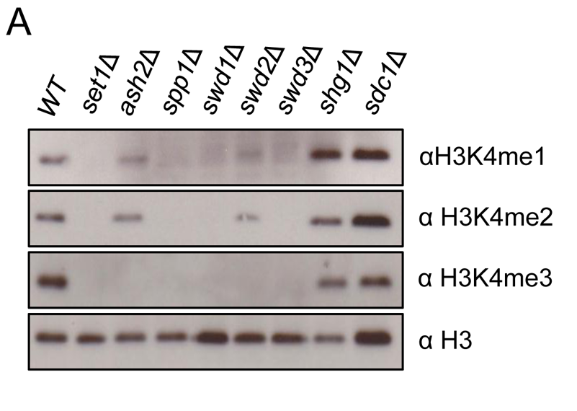
Teaching how to analyze primary literature in molecular biology—Erin Green
Learning Goal:
Analyze and evaluate the methods, data and conclusion of primary papers in molecular biology
Approaches
Assessment
1. Literature search, review and analyze
Perceptions of reading poll
???
semester
2. Guided reading questions for primary papers
Reading pre- and post-test
Class
Group
Individual

Slide 5
Using a teaching cycle to promote students’ learning—Shuyan Sun
Goals
Activities
1. Before Class
Get students exposed to vocabularies and concepts
Students read the text and take online tests
Better understand concepts and rationales; know how to apply them properly
In-depth discussion of textbook materials and examples from the real world
2. Lecture Section
3. Lab Section
Learn computer programs and interpret output correctly
Hands-on activities; feedback from peers, TA and instructor
4. After Class
Know how to apply statistics to do research
Students analyze data to answer real research questions and write a scientific report

Slide 6
Engaging students around energy— Carlos Romero-Talamás
Goal
Have students actively participate in class on energy sources/storage
Methods
Students read media articles and view videos on relevant topics
In class discussions are interspersed with math derivations
Future work
Implement in other courses, and find quantitative measures to track progress and better assess changes or revisions.
Assessment
Observed ↑ engagement and participation (and class energy!); some students even send their own article suggestions.

Slide 7
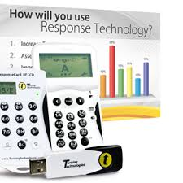
Increasing student engagement in a Methods class—Jamie Trevitt
Goals
Increase engagement
Improve understanding/teaching effectiveness
Plan
Use Turning Point Technologies “clickers”
to review/quiz students on material from
previous class
Assessment
Engagement ↑ – subjective, but seems so
Understanding/effectiveness – % correct on quizzes ↑
Attendance ↑ (nice “side effect”)

