Slide 1
Digital Literacies
Faculty Learning Community
Spring 2014
Members:
Diane Alonso (Psychology)
Kate Drabinski (GWS)
Milvia Hernandez (MLLI)
Erin Hogan (MLLI)
Edward Larkey (MLLI)
Ana Oskoz (MLLI)
Donald Snyder (MCS), facilitator
Mary Tabaa (EDUC)
Cynthia Wagner (Biology)

Slide 2
SPAN311: Poetic Images Collage
What: Visualize poetic images
How: Google Presentation
Objectives:
Close reading of poem with dictionary
Identify the images, form, tone of the poem
Choose the images that best suit the tone of the poem and treat each slide as a stanza
Present as a review for the poetry quiz
Erin Hogan Assistant Professor of Spanish
MLLI

Slide 3
Mary Tabaa
EDUC 794: Project Seminar (capstone course for MA TESOL program)
• Students design and develop instructional plans addressing real-life problems related to TESOL.
• In online section, students present their projects via at least two of the following tools/media.
o presentation software
o screencast
o video
o website
o videoconferencing
o other tool/medium approved by the instructor
• Students select presentation methods for type of instruction/training, content, and audience.
• Students will use presentations outside of course to promote their projects.

Slide 4
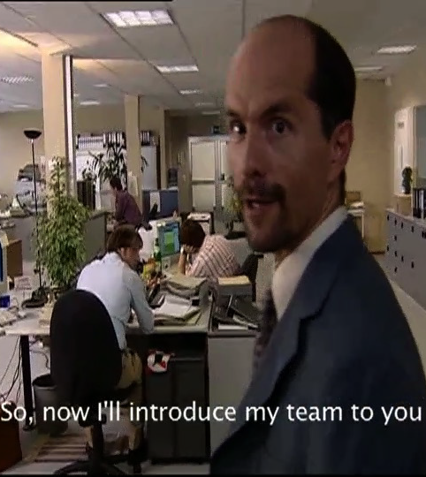
Larkey: German 319
German Translation: Subtitling Exercise
Subtitling a 5-Minute Segment of the German TV Series “Stromberg”
An adaptation of the UK TV Series “The Office”
Translate into English
Placement of subtitle in frame
Correct color and length of subtitle

Slide 5
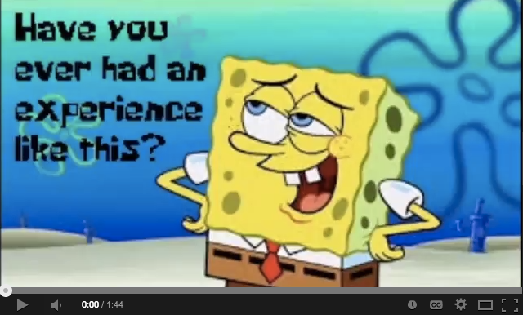
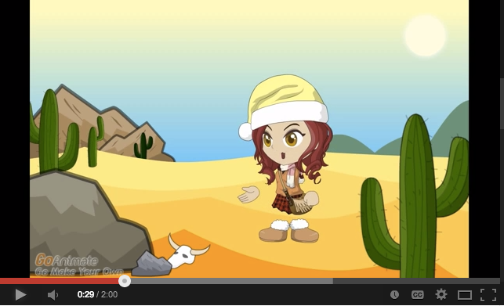
Creating Video Assignments for PSYC 415 (Diane Alonso)
Goal: To allow students to creatively express their knowledge of a concept in Cognitive Psychology (based on APA’s Noba Contest)
Process: Students worked either independently or in groups and used some form of video to convey one of the following 3 concepts:
(1) Memory (Encoding, Storage, Retrieval), (2) Factors Influencing Learning, (3) Forgetting and Amnesia
Evaluation Criteria: Students were evaluated in terms of:
(1) Accuracy, (2) Originality, (3) Clarity (Visual and Auditory), (4) The ability to effectively teach or demonstrate the chosen focus in a memorable way, (5) Organization and form
Outcome: A positive experience but there were lessons learned!
Notes:
Listing of links to the movies on YouTube (in order shown on screen). Note that the images in the screen are also linked to the videos.
Spongebob: https://www.youtube.com/watch?v=bs2YaVl69dw&list=PLLH47KM34us2auEGNI2JMk_FZsYOlxBoa
Amnesia Confessions: https://www.youtube.com/watch?v=qPv2_iDIwI4&index=4&list=PLLH47KM34us2auEGNI2JMk_FZsYOlxBoa
Amnesia: https://www.youtube.com/watch?v=DM_mw_qbcm4
Smoothie Movie: https://www.youtube.com/watch?v=ujLtljCr9WY&index=5&list=PLLH47KM34us2auEGNI2JMk_FZsYOlxBoa

Slide 6
imovies in BIOL 123 Human Genetics for non majors (Wagner)
Students chose a human genetic disease on which to perform literature research and make an imovie:
Purpose: to disseminate information to classmates
Length: 5-8 minutes
Very successful
imovies concisely summarized diseases creative ways
Much more interesting than PowerPoint presentations!
Improvement for next year
More in-class for groups to work on project (3 days instead of 1.5 days)

Slide 7
SPAN 202: Intermediate Spanish 2 Milvia Hernandez
Digital Assignment 1:
“Mi experiencia y mi futuro con el español” (My experience and future with the Spanish)
Students will create a digital story in which they will narrate their experience learning Spanish. Moreover, students will end their story with their future plan of the language in their professional careers. This is an individual project, and it will be presented to the class.
Digital Assignment 2:
Students will choose a topic to create a digital story that it has been interested in related topics covered in the course. One of the objectives for this digital assignment is creativity, and appreciation of the language and culture. This is an individual project, and it will be presented to the class.
For both digital assignments, students will be graded based on rubrics.

Slide 8
Oscoz: SPAN 10: Create a group page in Facebook
Setting:
Hybrid summer class
6 weeks
Two face-to-face meetings + virtual environment
Goals:
To create a community of language learners
To promote communication among class members
To practice linguistic structures presented in the class
Each week learners:
Post three entries related to the topic seen in class (e.g., likes and dislikes, daily activities)
Comment on two other classmates postings
Like two other classmates postings
Evaluation
Content and accuracy of post
1% extra for the persons with more “likes” and comment

Slide 9
Drabinski: GWST 200: Studies in Feminist Activism
Collaborative Activist Blog
http://umbcactivism.wordpress.com/
Self Designed Activist Projects - A Living Journal and a Tool for Reflection
Blog as an Online Archive of Student Activist Work
Blog as a Resource for Future Versions of the Course (A Community of Knowledge and Practice)
Potential Data for Future Scholarship of Teaching and Learning on ‘Teaching Activism Inside Institutions’

