Slide 1
Contemplative Pedagogy FLC
Sarah Leupen | Biology | Animal Physiology
Cynthia Wagner | Biology | Human Genetics (non-majors)
Stephen Mang | Chemistry & Biochemistry | The Chemistry of Climate Change
C. Jill Randles | Undergraduate Education | First-year Experience: Turning to one another: Beliefs and Behaviors
Mariajose Castellanos | Chemical, Biochemical & Environmental Engineering | Capstone Project Chemical Engineering
Robin Farabaugh | English | Shakespeare
Robin Barry | Psychology | Couples and Family Therapies

Slide 2
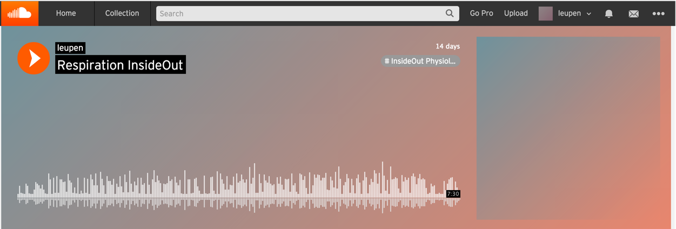
Inside Out Physiology podcasts
Sarah Leupen
5-8 minute podcasts that give the big picture of a physiological system while reminding students that all this physiology “is happening inside you right now”!
Students are told to close their eyes and focus on the sound– no multitasking!

Slide 3
BIOL 123: Human Genetics for non-majors
Cynthia Wagner
Made one cellular journey recording that describes the process of meiosis
Posted in Bb, as an optional exercise
(I felt somewhat constrained for time in class as four of our class times were canceled because of the snow)
Plan to make more of cellular journey recordings and introduce them into BIOL 302 (Molecular and General Genetics) in the fall of 2015 and again for the BIOL 123 in the spring of 2016

Slide 4
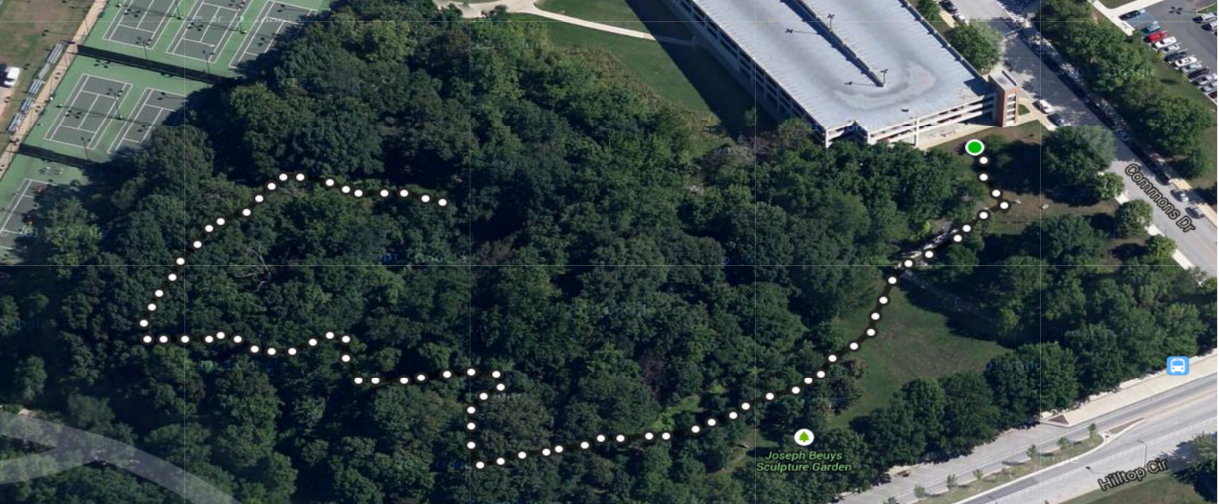
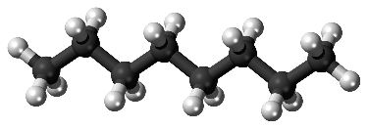
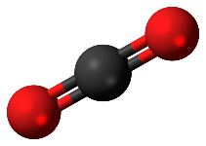
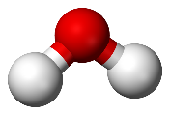
Contemplative Pedagogy in an Honors Seminar HONR 200: The Chemistry of Climate Change
14 students Mix of STEM and non-science majors
Stephen Mang
Meditative Walking
Students read an excerpt from The End of Nature
We met for class at Commons garage and took a silent walk (1/4 mile)
Discussion & writing assignment
“Nature as it existed before human activity no longer exists anywhere I’ve seen.”
Silent Listening
Students with no recent chemistry classes have a hard time with chemistry of combustion reactions
We did an exercise where they closed their eyes in a dark room and I described a reaction from the point of view of a carbon atom
Next class, most were able to recreate the process in writing without being prompted to study in the meantime
Sitting with eyes closed for 3+ minutes was a challenge for some students
+
+

Slide 5
First-Year Experience Course Turning to One Another: Beliefs and Behaviors
C. Jill Randles
Context: Course looks at how beliefs, morals, values, ethics, personal and spiritual development play out in behaviors. As a result of the conversations we had in the FLC, we elected to have our students “set the tone” for the class each week. It was a time to just take a breath.
Every week a different student shared something that, for them, represents sacred. This experience of taking just a few minutes at the start of the class to focus on something meaningful to a member of the class increased the degree in which members were present for one another, aware of their classmates, presented with an opportunity to learn about another religious/sacred practices which, very often, became the basis of conversation. In essence, we started class with a time for reflection and sharing…something we seldom take time to explore.
This gave students a time to mentally prepare for class and for engaging with each other and the course material. They became invested in each other, as they learned the course content. It enriched the experience.

Slide 6
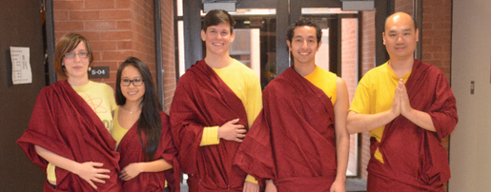
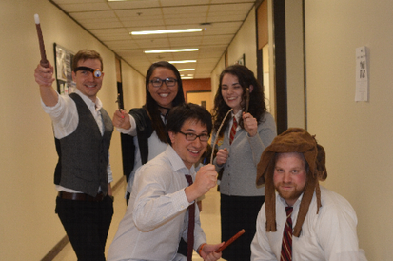
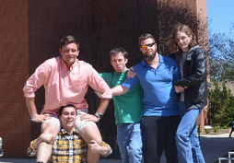
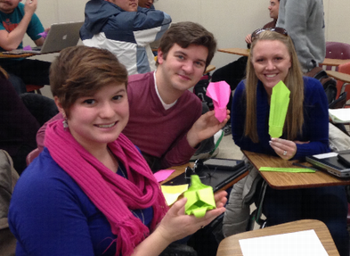
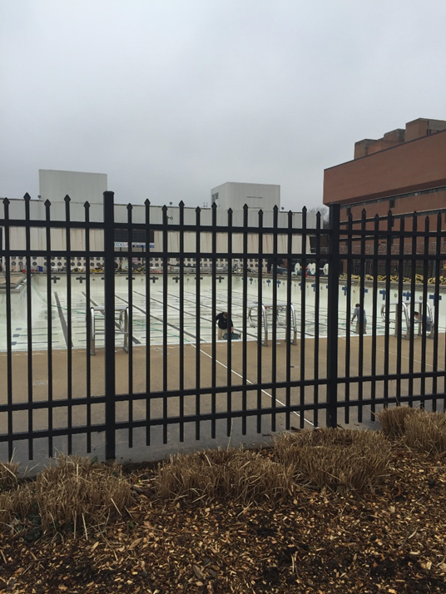
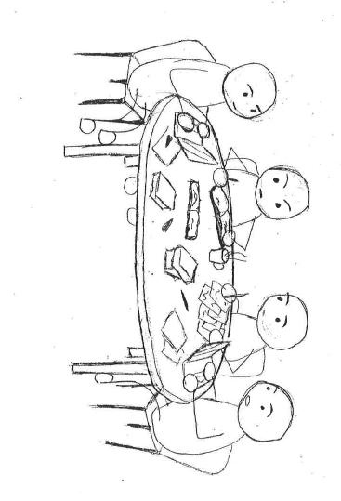
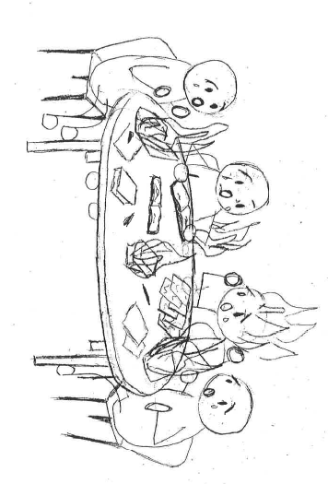
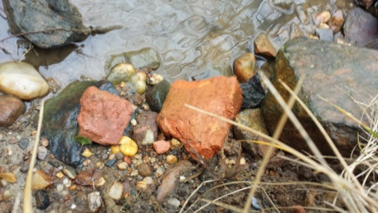
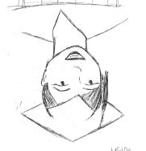
ENCH 446 Capstone Project Chemical Engineering: Design a chemical process to clean sour water
Movement & Visualization: view chemical process using nature and our campus buildings
Dr. C = Mariajose Castellanos
Mixer: Pollinating flowers is like dosing phosphoric acid.
Team work & Strengths: group dynamics presentations, digital stories, directed conversations
Nitrification Reactor: Open to the atmosphere. When filled with water, chemicals are reacting.
Breathing / Writing / Talking Exercises: Expectations & Reality, Songs & Strengths, Free Flow Writing, Teammates Strengths, Wishes
Denitrification Reactor: Anaerobic reactor, like an indoor pool.
Settling tank: Rocks are filtering compounds from water.
Expectations
Reality
WISH!

Slide 7
Reflective Reading and Writing
Simple tools for quiet learning:
Robin Farabaugh
Exercise 1:“…comfortable chair; bring your Shakespeare and leave behind phone or electronics. Close your eyes and listen to the ambient noises, breathing steadily. Listen to the breathing. After five minutes, open your eyes, open your copy of the play, and read. After each act, take a short walk, about five minutes, or repeat initial instructions.”
Writing prompt: “what effect did this have on your reading?”

Slide 8
Reflective Reading and Writing
Simple tools for quiet learning:
Robin Farabaugh

Slide 9
Reflective Reading and Writing
Simple tools for quiet learning:
Robin Farabaugh
Exercise 2: At the end of each play following Spring Break, you will write in class for 15 minutes, “taking stock” of what you notice. The first prompt: choose a theme you notice in all of the plays we’ve read so far. Choose specific moments from each and consider how the theme develops.
Two further prompts allowed students to develop their ideas further, or two switch themes
Final exam essay: Write on your theme, or one of the class generated themes, for 50 minutes. What have you learned?

Slide 10
Reflective Reading and Writing
Simple tools for quiet learning:
Robin Farabaugh

Slide 11
Reflective writing & silent discussion
Robin Barry
Will be asked to share with 1 other person.
Take piece of paper on table
When asked, reflect on all FLC presentations for 30 seconds (I will time).
What will you take away from this? (Don’t write until prompted)?
Write for 45 seconds (I will time). Then pass to person on left
Read reflections of other person, reflect on their notes and write your (respectful) response for 45 seconds
Return to original participant. Read their response
Passing, reading, reflecting and writing repeated several times, then I invite open discussion

